Slide 1




E-COMMERCE WEBSITE RECOMMENDATION SYSTEM
Presented By : Rolanda Azeem

Slide 2


GOAL
Build a recommendation system for e-commerce website
Personalize product discovery for users
Handle sparse interactions & popularity bias
Improve coverage and recommendations for new users
www.rolanda4.github.io

Slide 3




DATA UNDERSTANDING
Dataset
EVENTS (USER BEHAVIOR)
ITEM PROPERTIES (METADATA)
CATEGORY TREE (HIERARCHY)
www.rolanda4.github.io

Slide 4
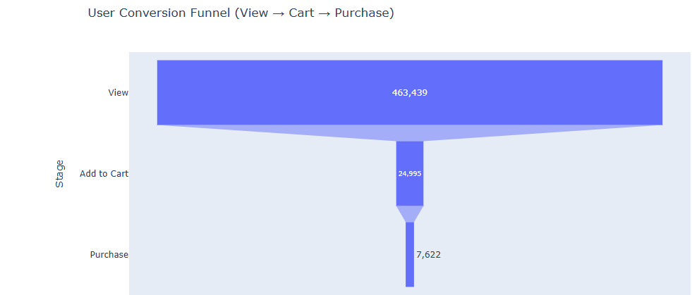
OBSERVATIONS
View >
addtocart >
transaction
www.rolanda4.github.io

Slide 5
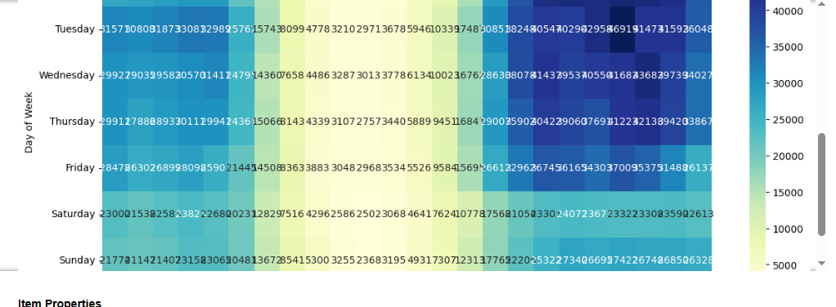
OBSERVATIONS
later hours
early in the week
www.rolanda4.github.io

Slide 6
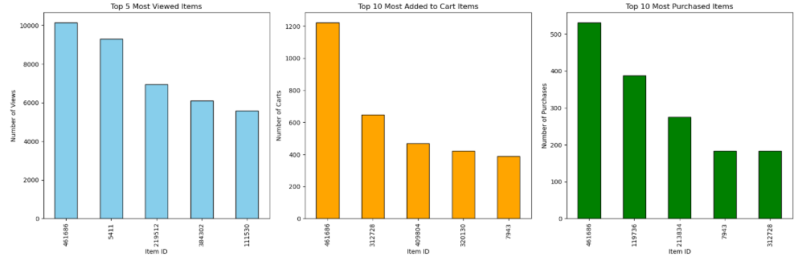
TOP 5 ITEMS BY EVENT
www.rolanda4.github.io

Slide 7
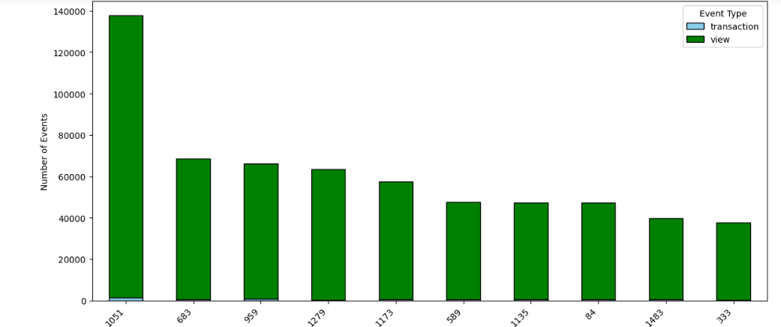
TOP 10 CATEGORIES
www.rolanda4.github.io

Slide 8

LIMITATIONS
User-item matrix is sparse
Many items have very few interaction
Implicit
www.rolanda4.github.io

Slide 9




DATA PREPARATION
CHRONOLOGICAL TRAIN-TEST SPLIT
BUILT SPARSE USER–ITEM MATRIX
EXPANDED CATEGORY HIERARCHY
WINSORIZATION TO CAP OUTLIERS
www.rolanda4.github.io

Slide 10
MODELING
POPULARITY-BASED RECOMMENDATION (BASELINE)
BAYESIAN PERSONALIZED RANKING (BPR)
ALTERNATING LEAST SQUARES (ALS)
www.rolanda4.github.io

Slide 11
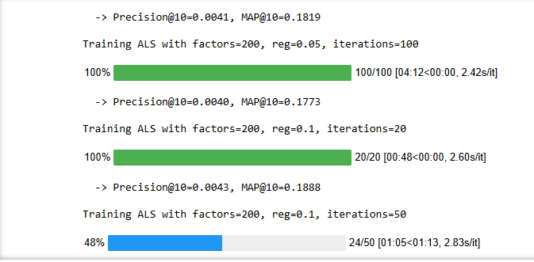
IMPROVING ALS
BM25 WEIGHTING TO REDUCE BIAS
HYPER-PARAMETER TUNING
(factors=50, reg=0.05, iterations=20)
[Precision@10= 0.0028, MAP@10= 0.1944]
www.rolanda4.github.io

Slide 12

FINAL MODEL (HYBRID)
ALS (60%)
POPULARITY (30%)
META-DATA SIMILARITY (10%)
*pending because of memory error
www.rolanda4.github.io

Slide 13

NEXT STEPS
SERVE THE MODEL IN E-COMMERCE WEB APPLICATION
WEEKLY UPDATES TO DATA AND MODEL TRAINING WITH UPDATED DATA
TRACK PRECISION@K AND MAP@K OVER TIME WITH A/B TESTING.
www.rolanda4.github.io

Slide 14
THANK YOU
Visit Online Repository
https://github.com/rolanda4/ecommerce_recommendation_system

